Slide 1


End of the Semester Project
LDPC Decoding for 5G NR
Group - 06
CT216 : Introduction to Communication Systems
Professor : Yash Vasavada
Mentor : Madhav Jivani

Slide 2
Honor Code
We declare that
The work that we are presenting is our own work.
→ We have not copied the work (the code, the results, etc.) that someone else has done.
→ Concepts, understanding and insights we will be describing are our own.
→ We make this pledge truthfully. We know that violation of this solemn pledge can carry grave consequences.

Slide 3
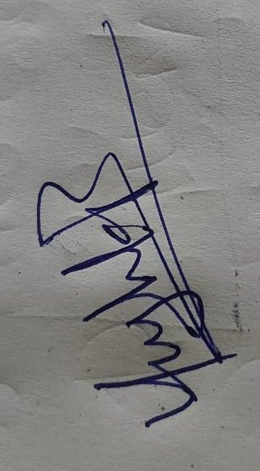

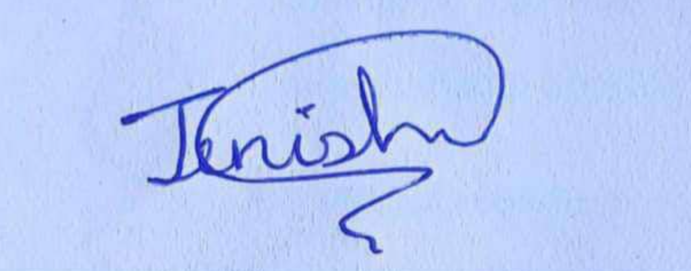
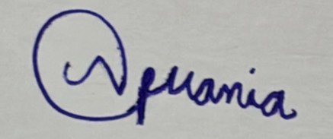
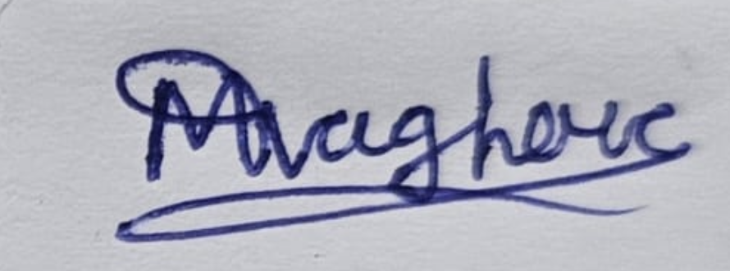
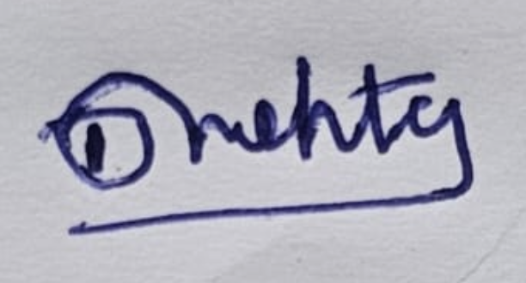

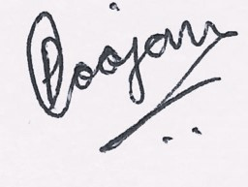
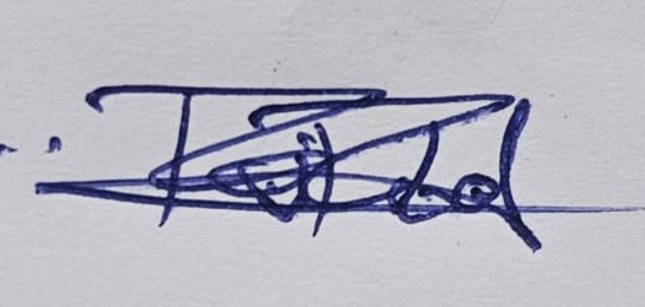
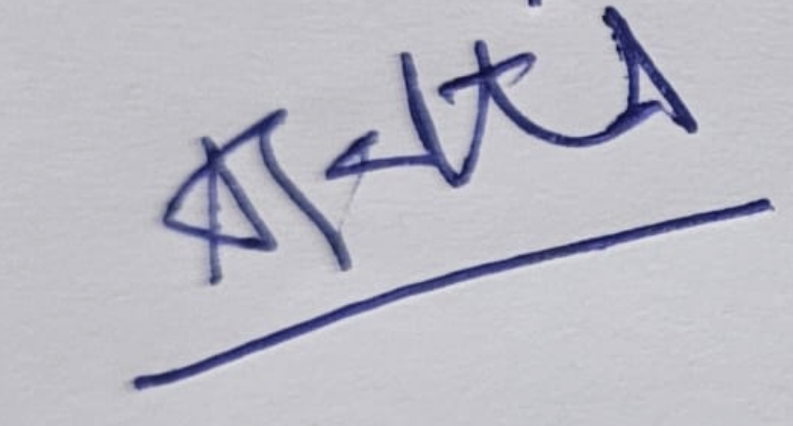

Signs :

Slide 4




Team Members
202301057 JENISH VASANI
202301058 BHANDERI RAJ SURESHBHAI
202301059 SHRADDHA RATHOD
202301060 NEERAJ VANIA
202301061 DHRUVIL MEHTA
202301062 MAULIK KHOYANI
202301063 VRAJESH DABHI
202301065 VANSH PADALIYA
202301064 URVESH DABHI
202301066 MAHEK VAGHERA
202101132 POOJAN SHAH

Slide 5



Introduction
LDPC (Low-Density Parity-Check) codes are special codes used to find and fix errors when data is sent over a noisy channel. They use a matrix that has mostly 0s and only a few 1s, which makes it "low-density." In this matrix, each column and each row has only a few 1s in fixed positions. Even though the check digits (extra bits used to find errors) are not placed in a simple pattern, we can still use the matrix to find and fix errors easily.
LDPC codes are not always perfect for small messages, but they work really well for large data and come close to the best possible performance. The best part is that they can be decoded using a simple and fast method, which makes them very useful in real-world systems like 5G, Wi-Fi, and satellite communication they are very good at finding and fixing errors in data during transmission. When data is sent through a noisy channel (like wireless or satellite communication), it can get changed or corrupted. LDPC helps protect the data by adding extra bits that let the receiver check for mistakes and correct them.

Slide 6
Model for LDPC
m
c
X
Message
LDPC encoder
Modulator
N
(AWGN)
Decoded Message
LDPC decoder
Demodulator
m
R
Y

Slide 7
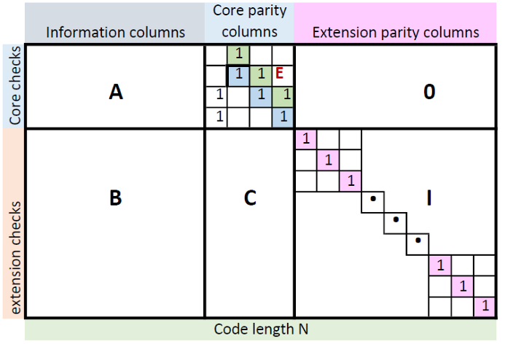
Base Graph
Both Base Graph 1 and Base Graph 2 used in LDPC codes follow the same block structure. The columns are split into three types: information columns (These columns represent the original data bits), core parity columns (These columns contain parity bits), and extension parity columns (These are extra parity bits added when needed (especially for longer code lengths). They help improve the error correction performance in more challenging conditions). The rows are divided into core check rows and extension check rows.
In Base Graph 1:
Matrix A is 4×22, E is 4×4 (a double diagonal matrix), O is a 4×42 , all-zero matrix, Matrix B is 42×22, C is 42×4, and I is a 42×42 identity matrix.
In Base Graph 2:
Matrix A is 4×10, E is 4×4, 0 is a 4×38 all-zero matrix, Matrix B is 38×10, C is 38×4, and I is a 38×38 identity matrix.

Slide 8
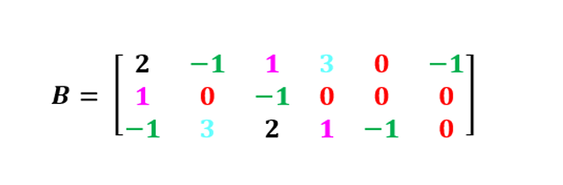
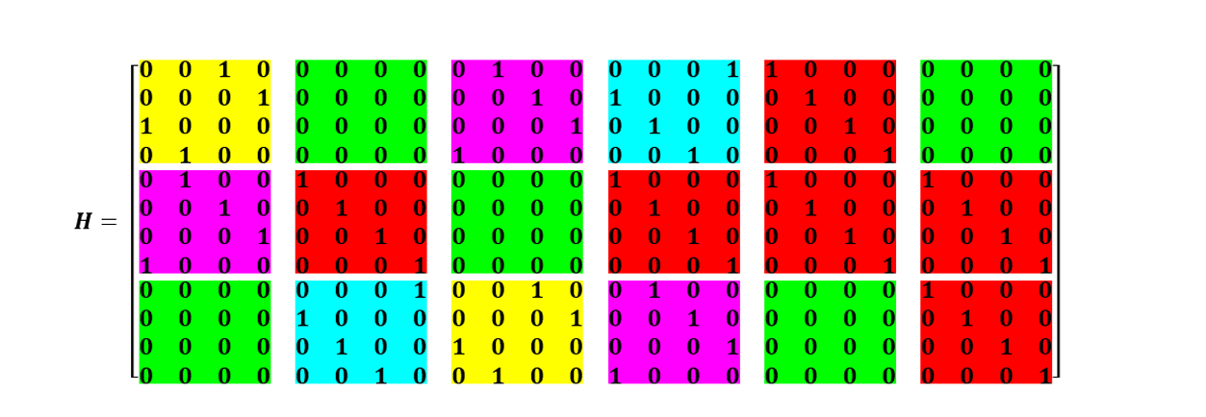
H
B Matrix:
H Matrix:

Slide 9
Parity check matrix calculation
To get the full parity-check matrix H, every entry in the base graph (H<sub>BG</sub>) is expanded into a Z×Z matrix based on its value:
If the entry is -1 → replace it with a Z×Z all-zero matrix
If the entry is 0 → replace it with a Z×Z identity matrix
If the entry is 1 → replace it with a Z×Z identity matrix shifted right by 1 column
If the entry is 2 → replace it with a Z×Z identity matrix shifted right by 2 columns
If the entry is k → replace it with a Z×Z identity matrix shifted right by k columns
This method creates the final H matrix used for LDPC encoding and decoding.

Slide 10
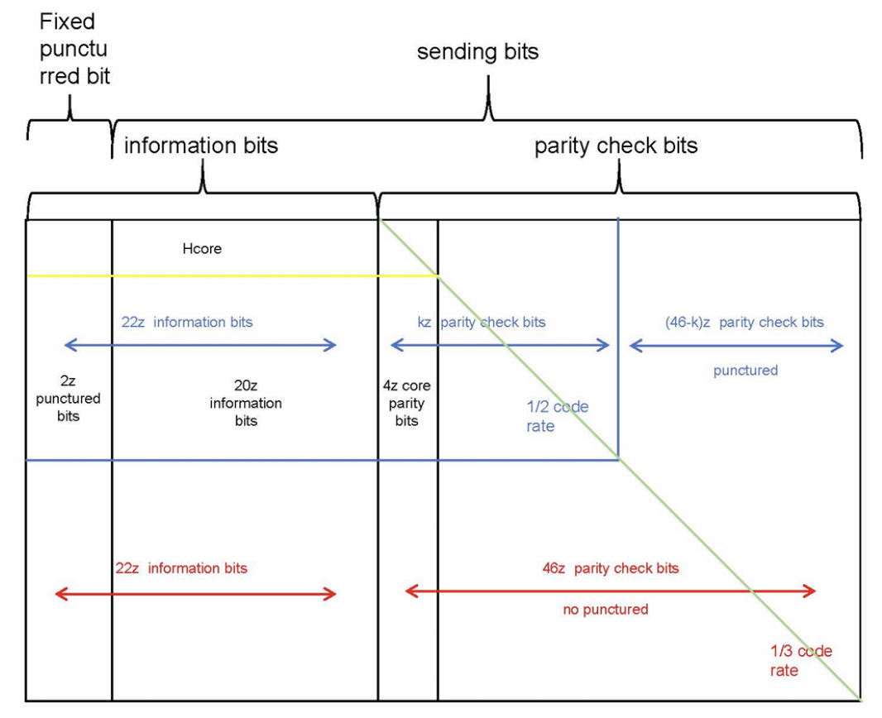
Puncturing
Puncturing is a technique used in channel coding where some of the encoded bits are not transmitted over the channel. These bits are intentionally removed to increase the code rate.
Higher code rate → Less redundancy → Lower error correction capability.

Slide 11
Rate matching in LDPC
For BG1, the base matrix size is 46 × 68, and z is the expansion factor.
Number of message bits = 22z
Total possible codeword bits = 68z
Puncturing in BG1:
The first 2z bits are punctured because the first two columns in the base matrix are high weight columns (means many entries are not -1).
So, these 2z message bits are not transmitted, but decoder is expected to recover them.
That means, number of transmitted bits = 66z
Lowest Code Rate:
In BG1, lowest supported rate is 1/3, which is:
Rate = 22z / 66z = 1/3

Slide 12
Rate matching in LDPC
Similarly, for BG2, lowest rate is 1/5
Rate = 10z / 50z = 1/5
What If We Want Higher Code Rate? (Rate Matching)
Example: Rate 1/2
We transmit only first 44z bits
Last 22z parity bits are punctured
Inside that 44z, always 22z are message bits
Puncturing means: we are not sending the bits, but they have non-zero reliability
So the rate becomes:
22z / 44z = 1/2

Slide 13
Rate matching in LDPC
Example: Rate 2/3
Transmit 33z bits:
20z message + 13z parity
So, rate is:
20z / 33z = ~2/3
Decoder Changes According to Rate
For rate 1/2, decoder will use left top matrix of size 24 × 46
For rate 2/3, decoder will use left top matrix of size 13 × 35
With LDPC, you are not limited to lowest rate only – you can choose any rate as per need
Shortening in LDPC
Usually, message bits = 22z
Then the remaining bits = (22z - A) are set to zero → this is called shortening

Slide 14
Rate matching in LDPC
Puncturing in LDPC
Total parity bits = 46z
If only E bits are to be transmitted:
Then out of 46z parity bits, we transmit only E - (A - 2z) parity bits
So both message and parity bits can be punctured
Types of Puncturing:
Message bit puncturing → happens on left-most side
Parity bit puncturing → happens on right-most side

Slide 15
Rate matching in LDPC
Summary of Shortening & Puncturing
If A < 22z, then we do shortening:
Set the missing message bits to zero, then add as much parity as required to meet the rate.
Define:
E = number of bits to transmit
A = message bits (includes first 2z punctured columns)
A - 2z = actual message bits that are transmitted
If some bits are punctured (not transmitted), at the receiver side:
Replace them with zero values in the received vector

Slide 16
Rate matching in LDPC
Decoding Behavior
For shortened message bits:
Set reliability r = very large positive number
For punctured parity bits:
Set LLR = 0
If columns are discarded and decoding can't happen, decoder just works with what's available

Slide 17
Encoding
m1,m2,...,mk
c1,c2,...,cn
LDPC encoder
To generate LDPC codewords:
Start with B matrix: First, convert the base matrix B into the H matrix using the expansion rules mentioned earlier.
C=[m1,m2,m3,…mk,p1,p2..,pn] where the first K bits are message bits and the last n bits are parity bits.

Slide 18
Encoding
Apply parity-check condition :
Multiply the H matrix with the transpose of codeword vector: H⋅C^T=0 This gives a system of linear equations.
By solving equations to find values of parity bits p1,p2..,pn Once parity bits are known, you get the complete codeword C.
Encoding Algorithm :
First, we expand the Base Matrix
For all entries of Bij:
if Bij == -1:
Replace Bij with an all-zeros matrix of size Zc×Zc
Else :
Replace Bij with a cyclically shifted identity
After expansion, construct the full parity-check matrix H.
Let:
c=[m1,m2,…,mk,p1,p2,…,pn]
We want to find:
Parity bits p1,p2,…,pn
We will multiply the codeword with the H matrix:
H×c^T=0
Using the double diagonal structure of the matrix, we solve for parity bits easily (in sequential or back-substitution steps) .

Slide 19
BPSK Modulation
Signal Representation
Bit‐to‐Waveform Mapping
Let the codeword bit be c∈{0,1}. The BPSK symbol S = 1 - 2c takes the value -1 when c=1 and +1 when c=0.
Constellation Diagram
There are two points on the real axis:
“1” → -1
“0” → +1

Slide 20
AWGN
Transmitter
Receiver
s
y
i/p
i/p
BPSK mod
BPSK De-mod
n

Slide 21
AWGN
The AWGN channel introduces noise into the BPSK symbols, with a Gaussian distribution, having a mean of zero and a certain variance.
The received signal r at the receiver is the sum of the transmitted symbols s and the noise n, which is mathematically represented as:
r=s+n
In BPSK, the symbols are usually +1 and -1. Average symbol power is:
Ps = E [s^2] = 1.
This is the power of the noise added by the AWGN channel.
AWGN is random with a Gaussian distribution, usually with mean =0 and Variance = σ^2
Noise Power=E[n^2]=σ^2.
So, SNR = symbol power / noise power.

Slide 22
Error performance over AWGN
For coherent BPSK in an Additive White Gaussian Noise channel, the bit‑error rate is
Pb=Q (sqrt(2Eb/N0)) =1/2 erfc (sqrt(Eb/N0)) , where Q(x) is the tail probability of a s standard normal.
To achieve Pb=10^{-5}, you need about Eb/N0≈9.6 dB.
BPSK Demodulation:
Decision Rule
Because BPSK’s two symbols are symmetric about zero, the optimum threshold is 0.
s^={+1,y>0,−1,y≤0.}⟹ c ^=(1-s^)/2 ( “1” -> -1 , “0” -> +1)
If y>0, you decide the transmitter sent “+1” → bit 0.
If y<0, you decide the transmitter sent “-1” → bit 1.

Slide 23
Decoding
y1,y2,...,yN
h1,h2,...,hn
LDPC decoder
There are two kinds of decoding algorithms for LDPC decoding.
One decoding algorithm is called hard decision decoding, in which The message passed contains the actual value of bits, such as Bit Flipping Algorithm.
The other decoding algorithm is called soft decision decoding , in which the message passed is the probability value associated with the occurrence of a particular bit .
Soft decision decoding is based on the idea of belief propagation. For example, BP Algorithm is soft decision decoding.
We will consider soft decision decoding algorithms because soft decision decoding algorithms in the log domain provide better performance than hard decision decoding algorithms regardless of the SNR level.

Slide 24
Hard Decision Decoding

Slide 25
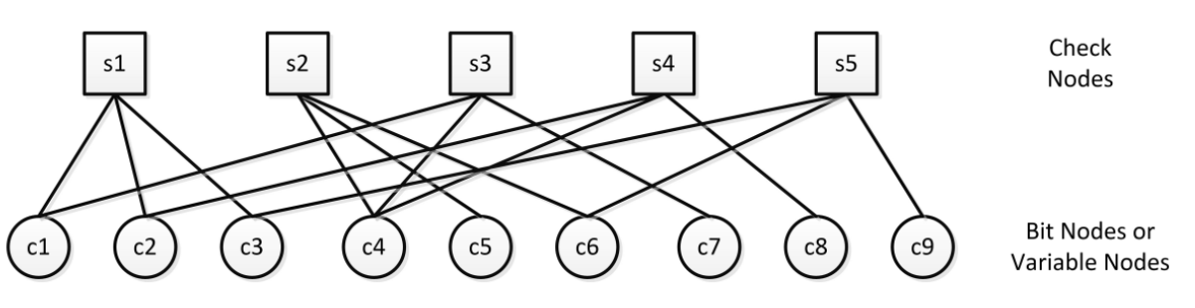
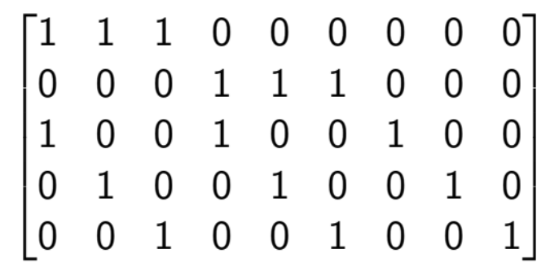
Hard Decision Decoding
This parity check matrix H can be represented by a Tanner Graph,
which is a Bipartite Graph:
H =

Slide 26
Hard Decision Message Passing
Algorithm
Message Passing Iterative Decoding Algorithm
• The received bits are used to compute initial messages from check nodes
(CNs) to variable nodes (VNs).
• Iteratively, messages are exchanged between CNs and VNs
• ach CN computes its outgoing messages based on incoming messages
from connected VNs
• Similarly, each VN computes its outgoing messages based on incoming
messages from connected CNs.

Slide 27
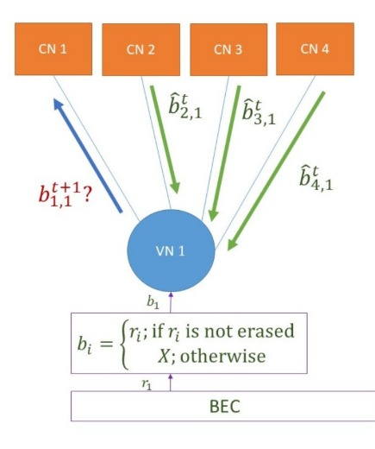
Hard Decision Message Passing
Algorithm
Since each VN is a repetition code, the decoding follows that of the repetition code
(As per taught in class)

Slide 28
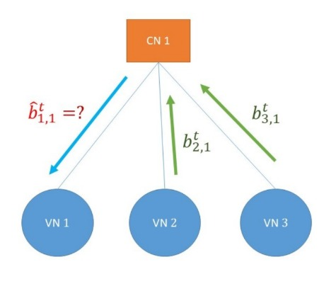
Hard Decision Message Passing
Algorithm
Since each CN is a SPC code, the decoding follows that of the SPC code
(As per taught in class)

Slide 29
Soft Decision Decoding

Slide 30



Storage Matrix L
L: Sparse matrix of same dimensions as parity-check matrix
NR, rate-1/2: L is a (22 x 46) * 48 sparse matrix
Toy example: L is a 4 x 7 matrix
L[i,j] = 0 if H[i,j] = 0
L[i,j] can be nonzero only if H[i,j] = 1
We will use above matrix for illustration
Typically, a much larger matrix is used!

Slide 31
[ 1 1 1 0 1 0 0 ] H = [ 0 1 1 1 0 1 0 ] [ 1 1 0 1 0 0 1 ] [ 1 0 1 0 1 1 1 ]
L = [ x1 x2 x3 0 0 x4 0 ]
[ 0 x5 x6 x7 0 x8 0 ]
[ x9 x10 0 x11 0 0 x12 ]
[ x13 0 x14 0 x15 x16 x17 ]
r = [ r1 r2 r3 r4 r5 r6 r7 ]
[ r1 r2 r3 0 r5 0 0 ]
L = [ 0 r2 r3 r4 0 r6 0 ]
[ r1 r2 0 r4 0 0 r7 ]
[ r1 0 r3 0 r5 r6 r7 ]
L[ N[j, i], j ] = rj for j = 1, 2, ..., n and for i = 1, 2, ..., t[j]

Slide 32
For each row , Min-Sum SPC SISO
Magnitude
Min1 = minimum absolute value of all nonzero entries in row
Min2 = next higher absolute value
Set magnitude of all values (except minimum) = Min1
Set magnitude of minimum value = Min2
Sign
Parity = product of signs of entries in row
New sign of an entry = (Old Sign) × (Parity)

Slide 33

r = [ 0.2 -0.3 1.2 -0.5 0.8 0.6 -1.1 ] [0.2 - 0.3 1.2 0 0.8 0 0] L = [0 -0.3 1.2 -0.5 0 0.6 0] [0.2 -0.3 0 -0.5 0 0 -1.1] [0.2 0 1.2 0 0.8 0.6 -1.1]
Initialization

Slide 34
[ 0.2 -0.3 1.2 0 0.8 0 0 ] L = [ 0 -0.3 1.2 -0.5 0 0.6 0 ] [ 0.2 -0.3 0 -0.5 0 0 -1.1 ] [ 0.2 0 1.2 0 0.8 0.6 -1.1 ] Row Operation on Row 1 [ -0.3 0.2 -0.2 0 -0.2 0 0 ] L = [ 0 -0.3 1.2 -0.5 0 0.6 0 ] [ 0.2 -0.3 0 -0.5 0 0 -1.1 ] [ 0.2 0 1.2 0 0.8 0.6 -1.1 ]
[0.2 -0.3 1.2 0 0.8 0 0] L= [0 -0.3 1.2 -0.5 0 0.6 0] [0.2 -0.3 0 -0.5 0 0 -1.1] [0.2 0 1.2 0 0.8 0.6 -1.1] Row Operation on Row 2 [-0.3 0.2 -0.2 0 -0.2 0 0]
L = [ 0 -0.5 0.3 -0.3 0 0.3 0] [ 0.2 -0.3 0 -0.5 0 0 -1.1] [ 0.2 0 1.2 0 0.8 0.6 -1.1]

Slide 35
[ 0.2 -0.3 1.2 0 0.8 0 0 ] L = [ 0 -0.3 1.2 -0.5 0 0.6 0 ] [ 0.2 -0.3 0 -0.5 0 0 -1.1 ] [ 0.2 0 1.2 0 0.8 0.6 -1.1 ] After Row Operation [ -0.3 0.2 -0.2 0 -0.2 0 0 ] L = [ 0 -0.5 0.3 -0.3 0 0.3 0 ] [ -0.3 0.2 0 0.2 0 0 0.2 ] [ -0.6 0 -0.2 0 -0.2 -0.2 0.2 ]

Slide 36
In-place computation using L
For each column ( Min-Sum Repetition Code SISO).
New values
Sumj = rj + sum of all entries in Column j (total belief)
New Entry = Sum − (Old entry) (extrinsic)

Slide 37
r = [ 0.2 -0.3 1.2 -0.5 0.8 0.6 -1.1 ]
[-0.3 0.2 -0.2 0 -0.2 0 0 ] L = [ 0 -0.5 0.3 -0.3 0 0 0 ] [-0.3 0.2 0 0.2 0 0 0.2 ] [-0.6 0 -0.2 0 -0.2 -0.2 0.2]
Column Operation on Column 1
Sum = -1 [-0.7 0.2 -0.2 0 -0.2 0 0] L = [ 0 -0.5 0.3 -0.3 0 0 0] [-0.7 0.2 0 0.2 0 0 0.2] [-0.4 0 -0.2 0 -0.2 -0.2 0.2]

Slide 38
r = [ 0.2 -0.3 1.2 -0.5 0.8 0.6 -1.1 ]
[ -0.7 0.2 -0.2 0 -0.2 0 0 ]
L = [ 0 -0.5 0.3 -0.3 0 0.3 0]
[ -0.7 0.2 0 0.2 0 0 0.2]
[ -0.4 0 -0.2 0 -0.2 -0.2 0.2]
Column Operation on Column 2
Sum = [-1 - 0.4 ]
[-0.7 -0.6 -0.2 0 -0.2 0 0 ]
L = [ 0 0.1 0.3 -0.3 0 0.3 0 ]
[-0.7 - 0.6 0 0.2 0 0 0.2]
[-0.4 0 -0.2 0 -0.2 -0.2 0.2]

Slide 39
After column operation
R = [ 0.2 -0.3 1.2 -0.5 0.8 0.6 -1.1 ] <- from channel [-0.3 0.2 -0.2 0 -0.2 0 0]
L = [ 0 -0.5 0.3 -0.3 0 0.3 0] [-0.3 0.2 0 0.2 0 0 0.2] [-0.6 0 -0.2 0 -0.2 -0.2 0.2]
Sum = [ -1 -0.4 1.1 -0.6 0.4 0.7 -0.7 ] <- updated belief after 1st iteration
[ -0.7 -0.6 1.3 0 0.6 0 0] L= [ 0 0.1 0.8 -0.3 0 0.4 0] [-0.7 -0.6 0 -0.8 0 0 0.2] [-0.4 0 -1.3 0 0.6 0.9 -0.9]

Slide 40
If Sumᵢ > 0, decision on bit j = 0
If Sumᵢ < 0, decision on bit j = 1
(Assuming BPSK: 0 → +1 and 1 → -1)
After first iteration:
Sum = [ -1 -0.4 4.4 -0.6 0.4 0.7 ]
Dec = [ 1 1 0 1 0 0 ]
For more iterations, continue with new L.
More iterations → Better performance
About 5 to 8 is typically enough
Storage and efficient retrieval from the matrix L is vital for a good implementation.

Slide 41
Layer Decoding
Iterate between decoders for each layer
LLR₁₂
Decoder for C₁ uses ChLLR only in first iteration
LLR₂₁ is used afterwards
Reduces required number of iterations by ½
Converges faster
ChLLR
Decoder for c1
LLR₂₁
Decoder for c2

Slide 42
Layering in the LDPC Matrix
Rows of parity check matrix grouped into several layers
Column weight of each layer = 1 (typically)
H = [ H1 ] = [ 1 1 0 1 0 1 0 ] ← Layer 1
[ H2 ] [ 0 0 1 0 1 0 1 ]
[ --------------------]
[ 1 1 1 0 0 0 0 ] ← Layer 2
[ 0 0 1 0 1 0 1 ]

Slide 43

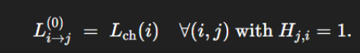
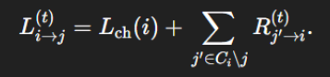

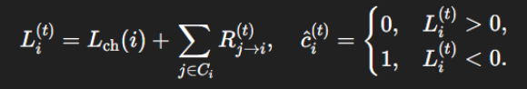

Sum‑Product Algorithm (SPA)
Initialization :
Variable‑node update (for each variable i, for each j ∈ Ci :
A‑posteriori LLR & decision (for each i):

Slide 44
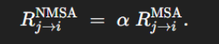
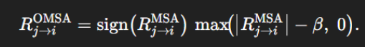
Optimized Min-Sum Decoding Algorithm:
Because MSA overestimates magnitudes, two simple fixes restore performance:
Normalized Min‑Sum (NMSA): scale every check‐node output by factor α ∈ (0,1) :
Offset Min‑Sum (OMSA): subtract a fixed β>0\beta>0β>0 (floor at zero):
Everything else—variable‑node updates, decision, syndrome checks—remains as in MSA.

Slide 45
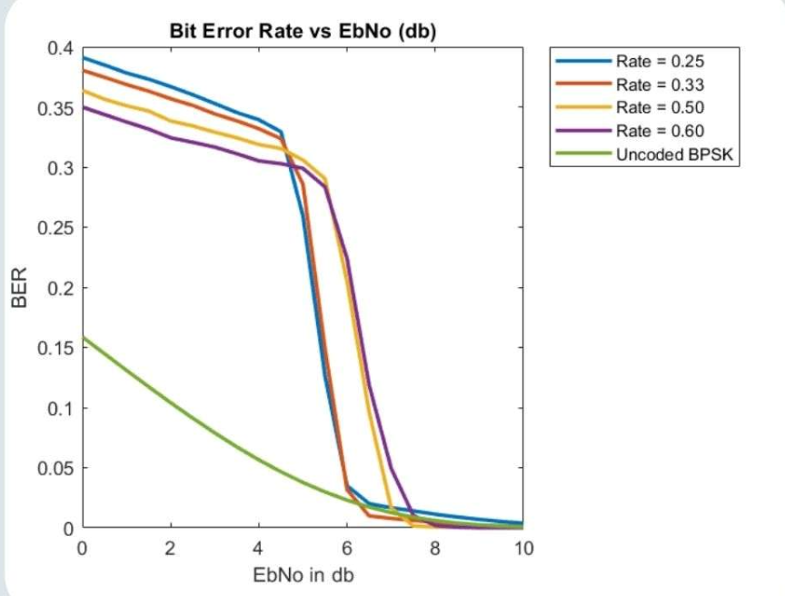
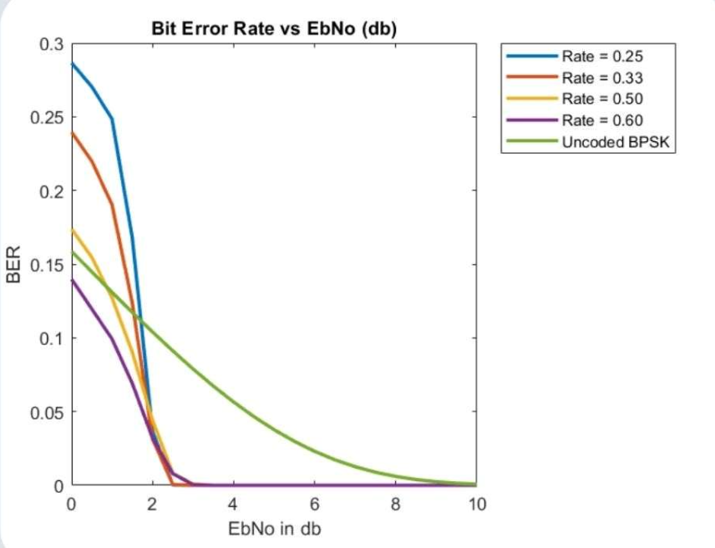
NR_2_6_52 Matrix
BER VS E_b/N_0(in db)
Hard Decoding
Soft Decoding

Slide 46
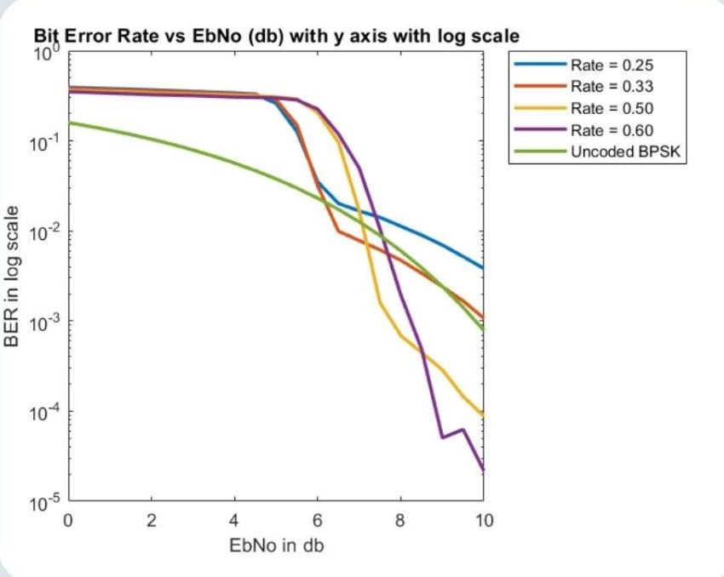
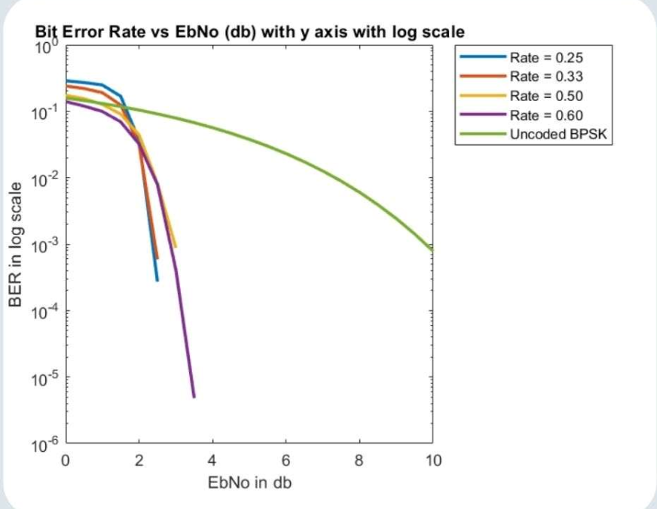
NR_2_6_52 Matrix
BER VS E_b/N_0(in db) in Logarithmic Scale
Hard Decoding
Soft Decoding

Slide 47
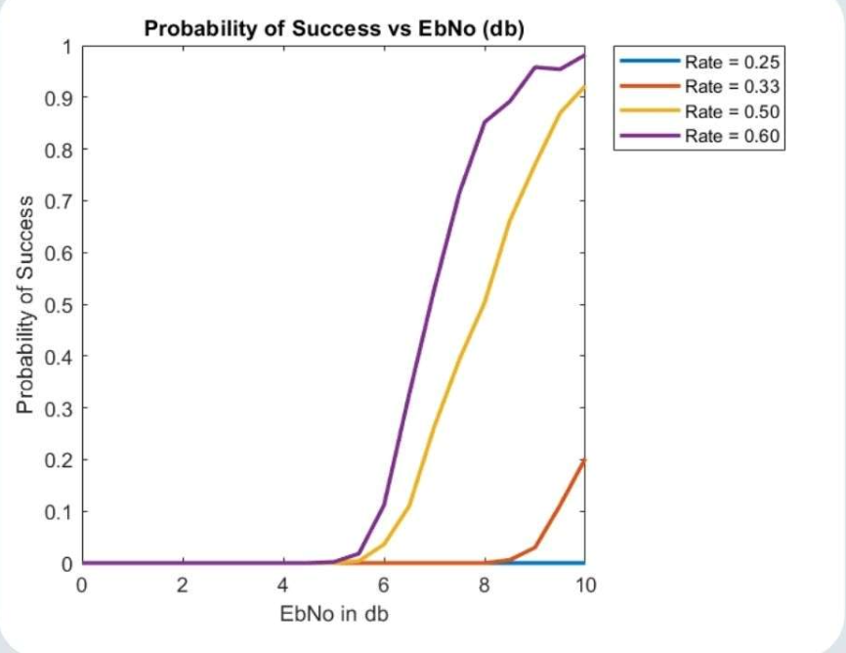
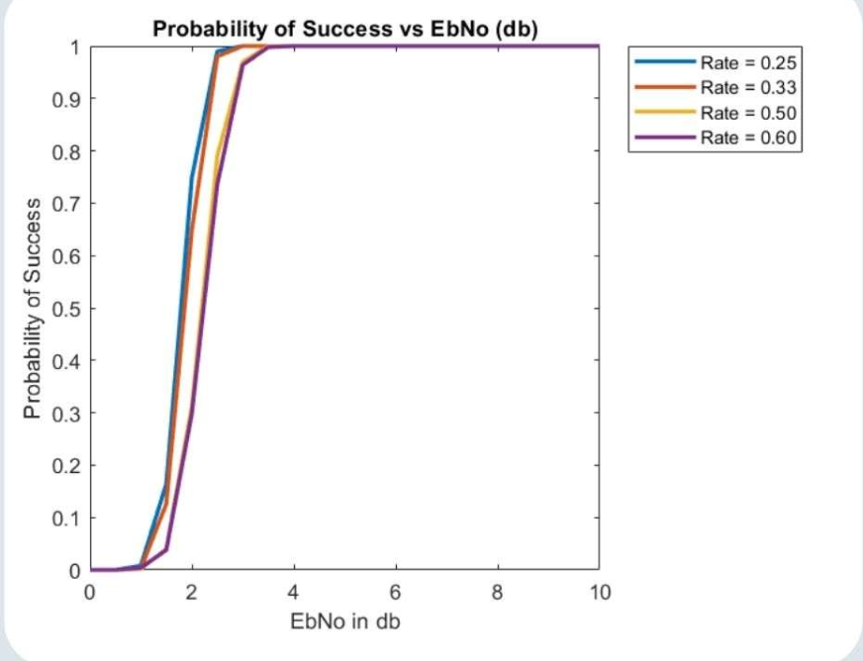
NR_2_6_52 Matrix
Probability of Success VS E_b/N_0(in db)
Hard Decoding
Soft Decoding

Slide 48
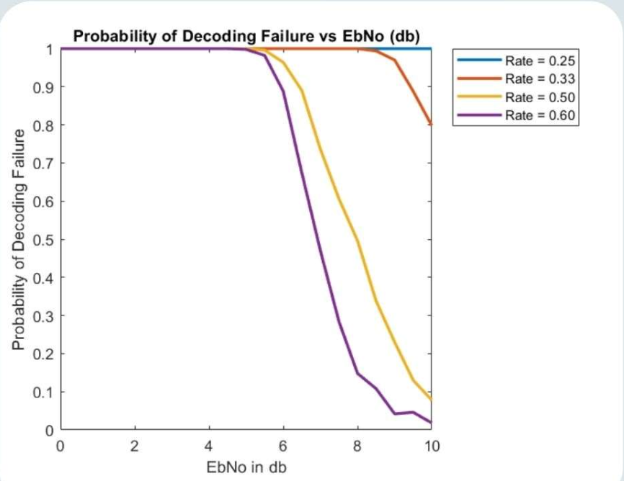
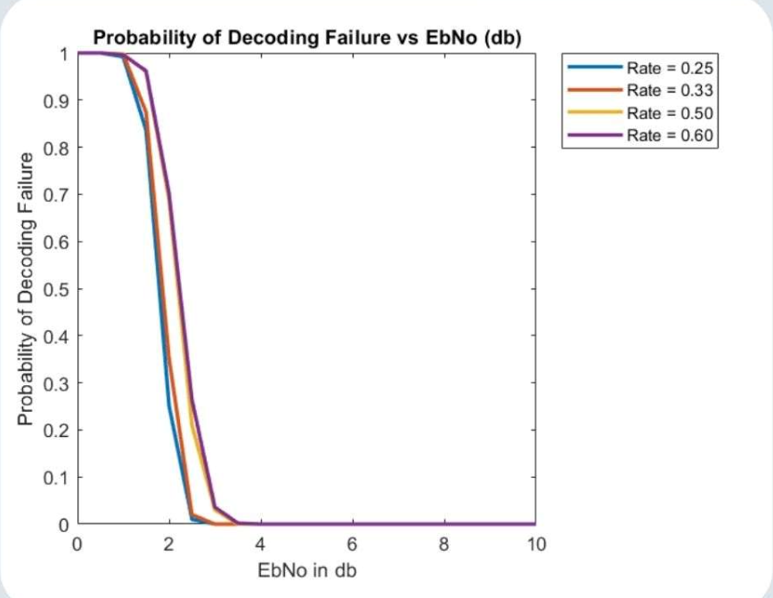
NR_2_6_52 Matrix
Probability of Error VS E_b/N_0(in db)
Hard Decoding
Soft Decoding

Slide 49
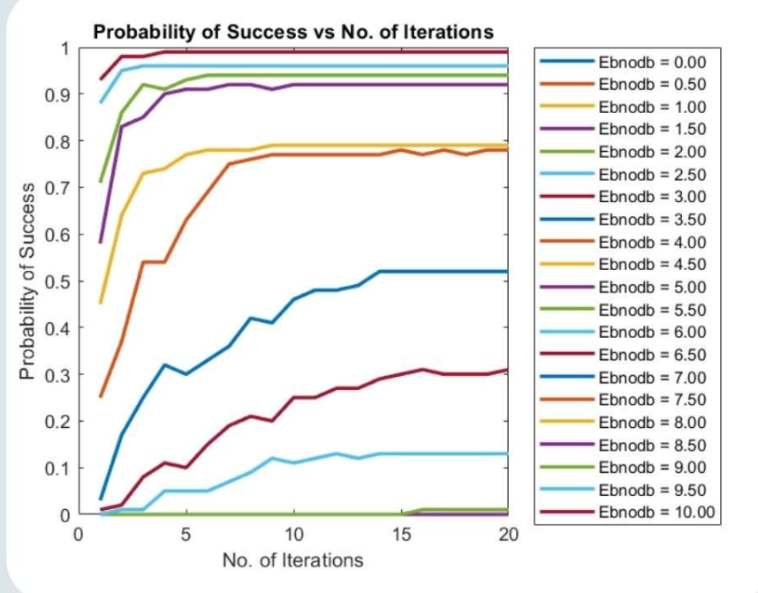
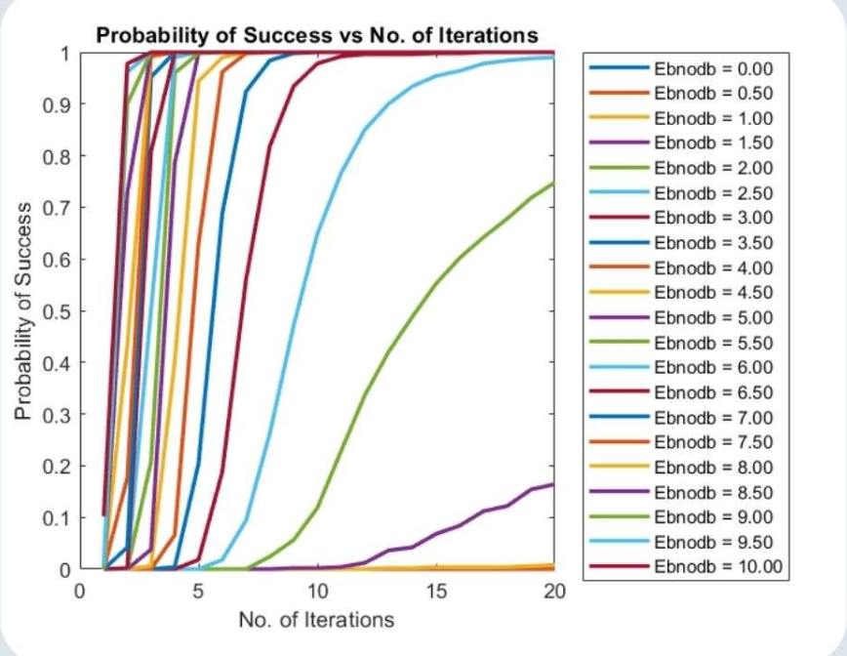
NR_2_6_52 Matrix
Probability of Success VS Number of Iterations
Hard Decoding
Soft Decoding

Slide 50
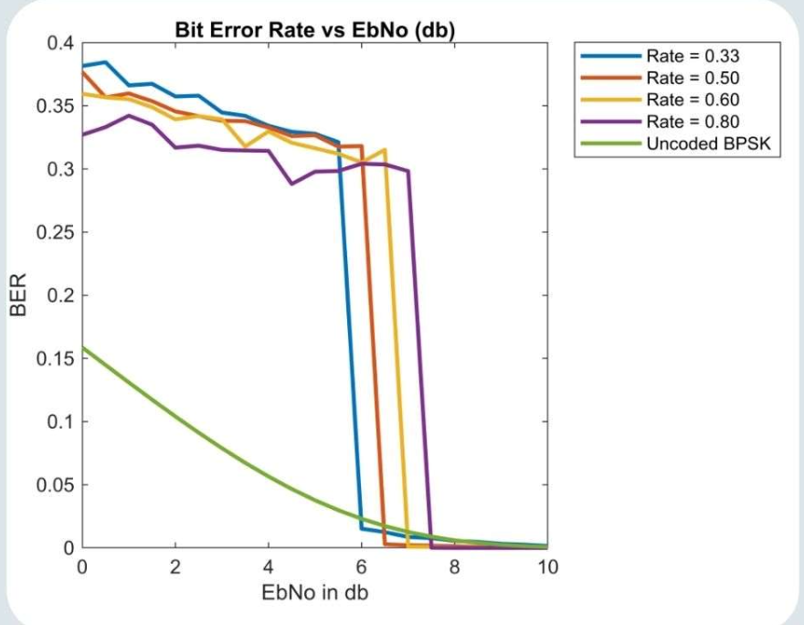
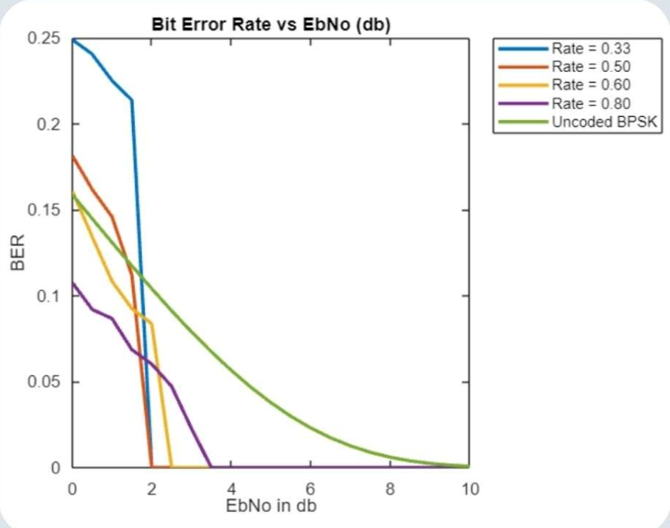
NR_1_5_352 Matrix
BER VS E_b/N_0 (in dB)
Hard Decoding
Soft Decoding

Slide 51
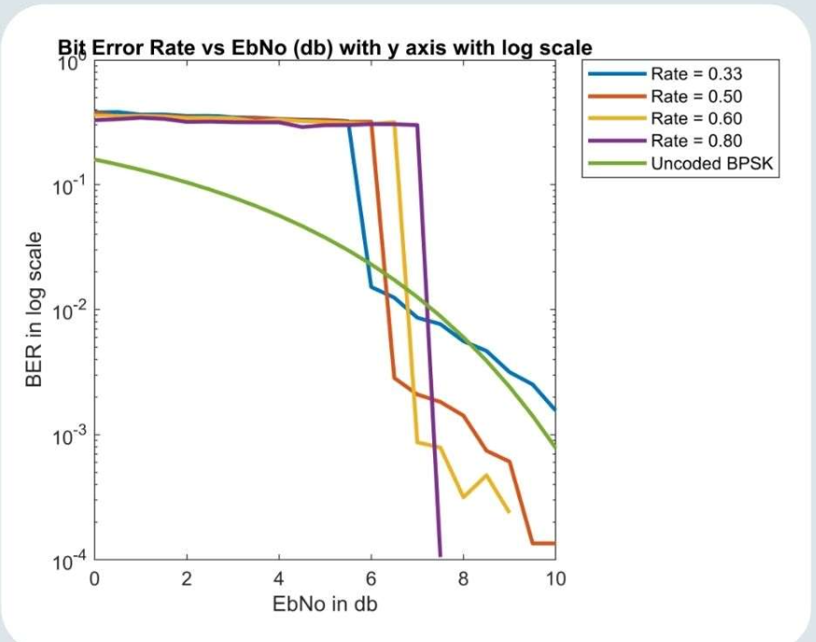
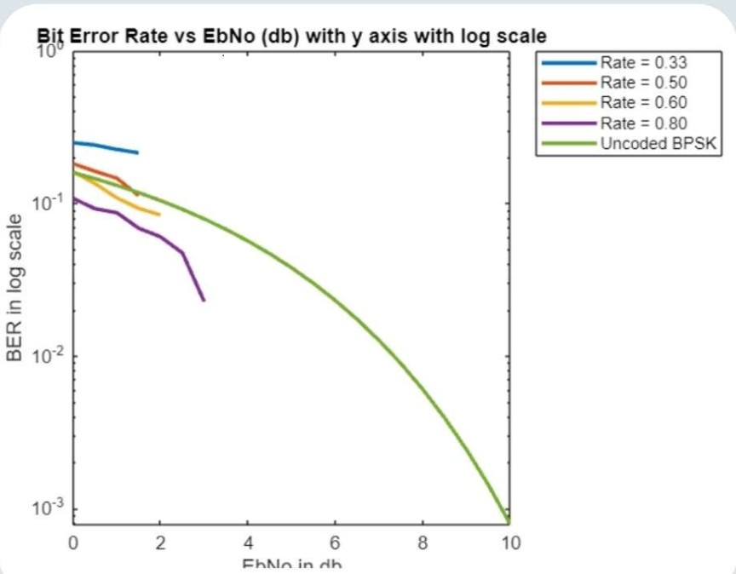
NR_1_5_352 Matrix
BER VS E_b/N_0 (in dB) in Logarithmic Scale
Hard Decoding
Soft Decoding

Slide 52
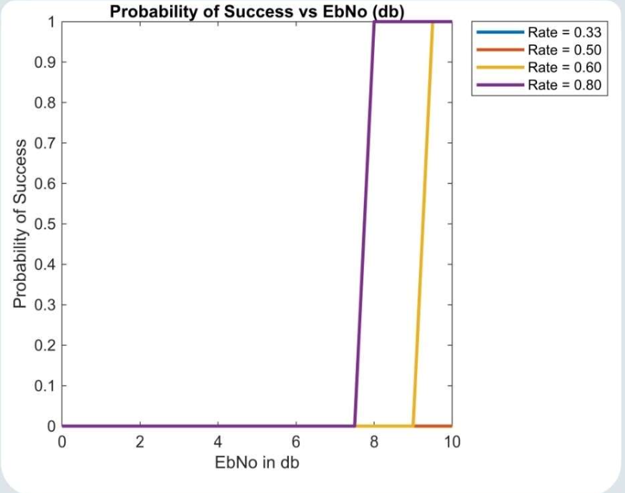
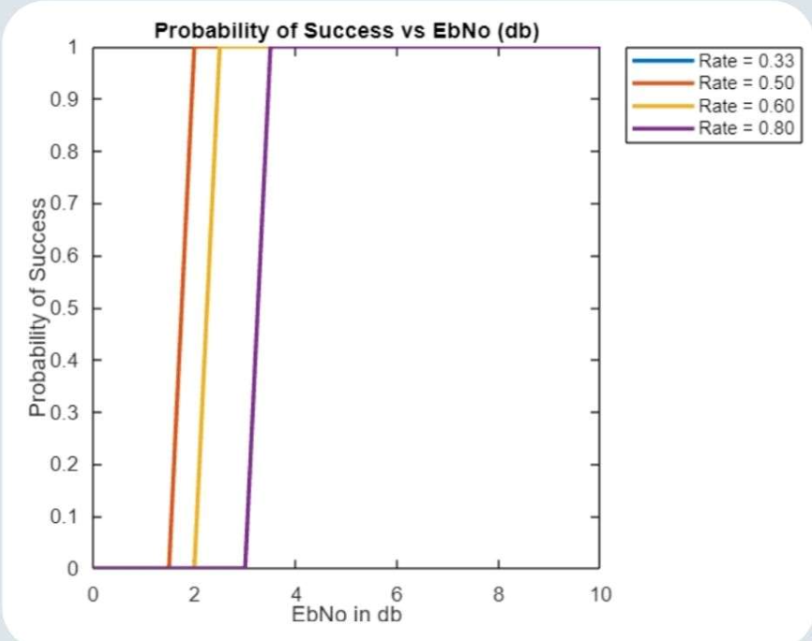
NR_1_5_352 Matrix
Probability of Success VS E_b/N_0 (in dB)
Hard Decoding
Soft Decoding

Slide 53
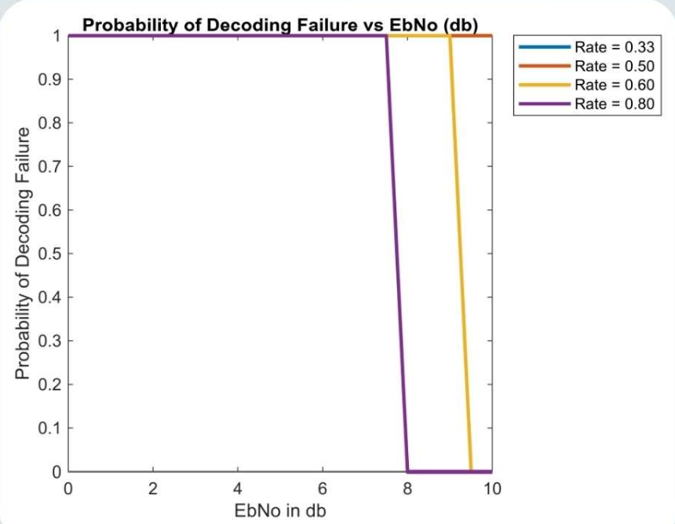
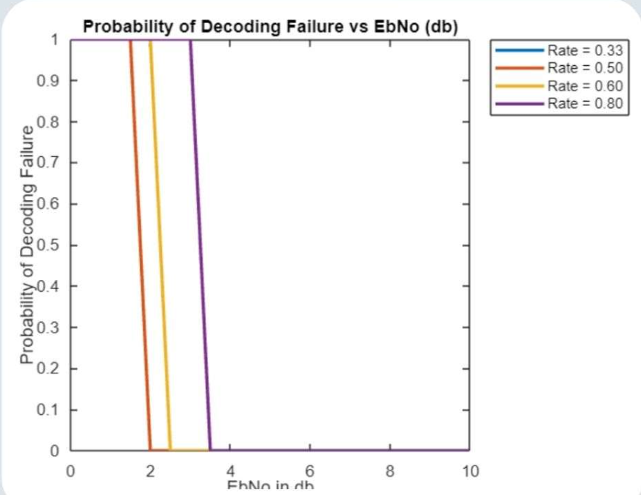
NR_1_5_352 Matrix
Probability of Error VS E_b/N_0 (in dB)
Hard Decoding
Soft Decoding

Slide 54
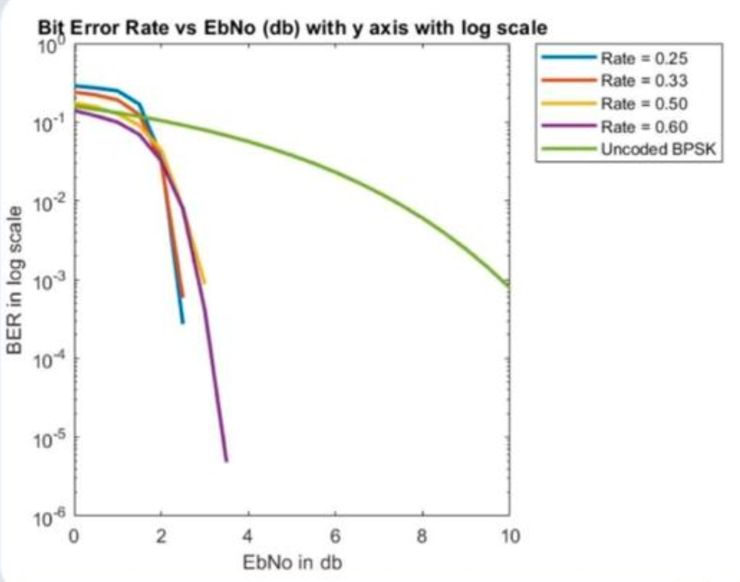
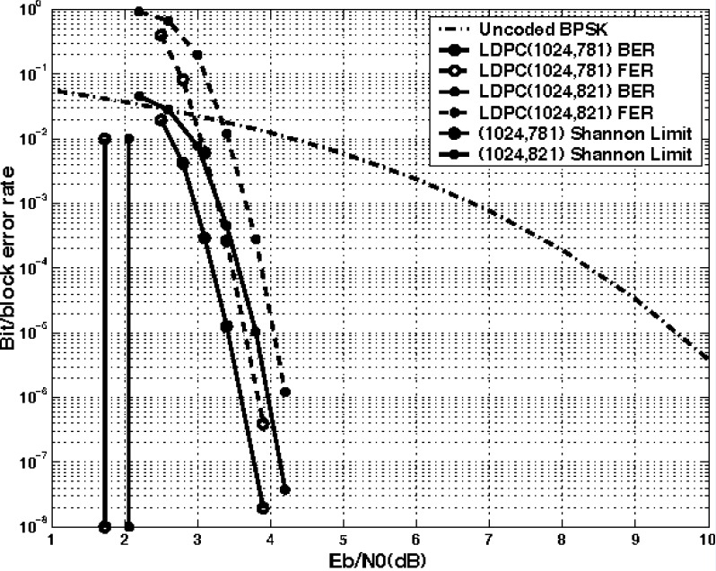
Comparison with Shannon’s Channel Capacity
LDPC BER
Shannon Capacity Rate

Slide 55
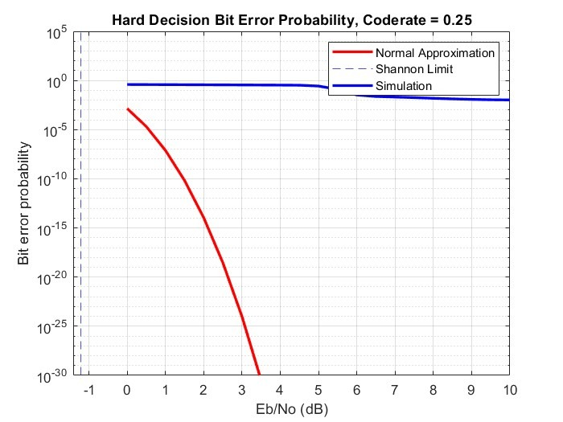
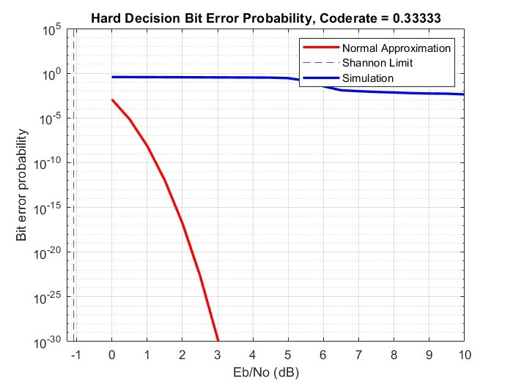
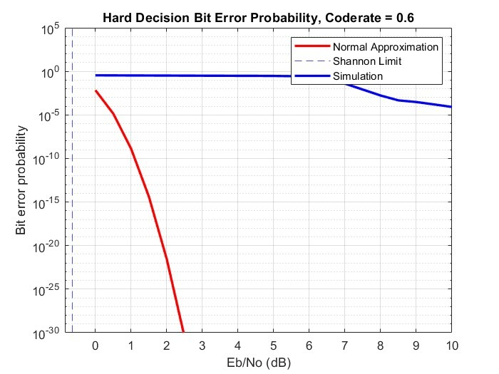
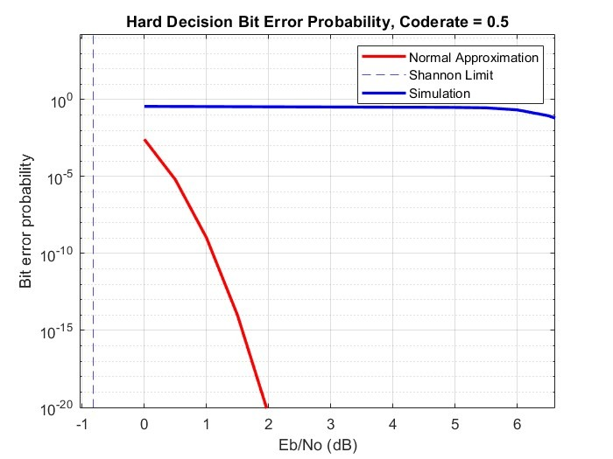
Comparison with Shannon Limit (Different Coderates)

Slide 56
LaTeX Project Report
https://drive.google.com/file/d/17FK7gQRPVFqQSTBVS0cldiTZw3MHMPxj/view?usp=sharing

Slide 57
Bibliography
LIFANG WANG | Implementation of Low-Density Parity-Check codes for 5G NR shared channels | DEGREE PROJECT IN COMPUTER SCIENCE AND ENGINEERING, SECOND CYCLE, 30 CREDITS STOCKHOLM, SWEDEN 2021.
Siqi Yu, Francis C. M. Lau, Kunyang Li | Decoding of 5G NR Low-Density Parity-Check Codes | 2024 The 9th International Conference on Computer and Communication Systems.
Andrew Thangaraj | LDPC and Polar Codes in 5G Standard, 2019.
Prof. Yash Vasavda | CT216 - Introduction to Communication Systems: Channel Coding, DA-IICT, Winter 2025.

Slide 58


Thanks!

